Slide 1
AI for robots
Jakub Mašlonka
Raya Golcheva
Maya Gomez

Slide 2
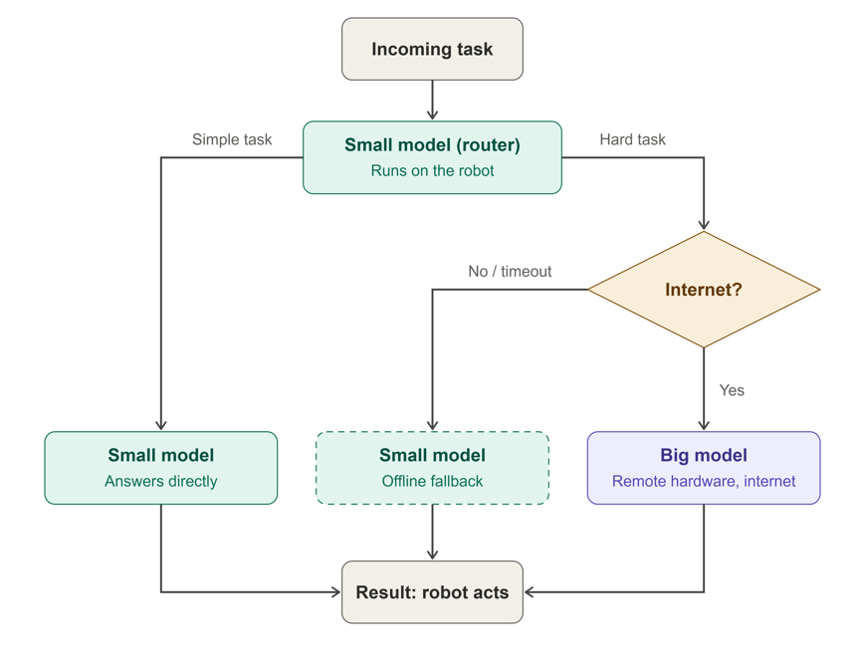
Introduction
Imagine a robot working in the real world, with no cloud connection and limited power and hardware. A big AI model is smart but heavy and slow.
A small model is fast and efficient but can only handle simple tasks.
So we use both. The robot runs two local agents that communicate. The small one handles simple tasks, and when it can’t solve something, it passes the task to the big one.
This saves energy, speeds up responses, and still gives the robot strong reasoning when it needs it. Today I’ll show how the two agents share the work.

Slide 3

Two Locations model
A small model on the robot, a big model on a server
Small model (on the robot): runs locally, handles everyday, simple tasks quickly and cheaply, and acts as the first responder
Big model (on a server): handles complex plans, unclear situations and unexpected obstacles with strong reasoning
The two models communicate over mobile connection
  Robot to server: the task, relevant sensor data and context, and how confident the small model is
  Server to robot: the decision, plan or instructions to execute
The small model decide which one is best suited for each task

Slide 4
The right model for the right task
A task comes in and the small model evaluates it on the robot
It checks how complex the task is and how confident it is in its own answer
If it’s simple or confidence is high, the small model solves it right away, with no network needed
If it’s complex or confidence is low, and the connection is available, the small model sends the relevant information to the big model
The big model reasons about it and sends the result back, and the robot executes it
What the decision depends on:
Task complexity and the small model’s confidence
Urgency: time-critical tasks stay local
Connection quality (Wi-Fi/5G) and battery level

Slide 5

Benefits:
-Saves energy and battery life on the robot
-Fast responses for everyday tasks
-Strong reasoning is available whenever the situation demands it
-Heavy computing stays on the server, so the robot stays light
-The robot keeps working even when offline
Better privacy:
-When the local model handles a task, the data (camera images, sensor readings, surroundings) never leaves the robot, and only the information that is really needed is sent to the server
If the connection is lost:
The robot simply keeps using the small model, so it never stops working
Simple tasks run exactly as normal
Complex tasks are handled with the small model’s best effort, and the robot can switch to cautious behavior, such as slowing down
Once Wi-Fi or 5G is back, the big model becomes available again

Slide 6
Task | Assigned model
Greeting visitors and small talk | Small model
Checking in a visitor from a fixed list | Small model
Giving simple directions in the building | Small model
Calling a human staff member | Small model
Simple yes/no and confirmation questions | Small model
Opening hours | Big model
Toilet location questions | Big model
Answering unusual or detailed questions | Big model
Understanding unclear or complicated requests | Big model
Handling complaints or sensitive situations | Big model
Translating less common languages | Big model
Writing a longer message or summary of a visit | Big model

Slide 7
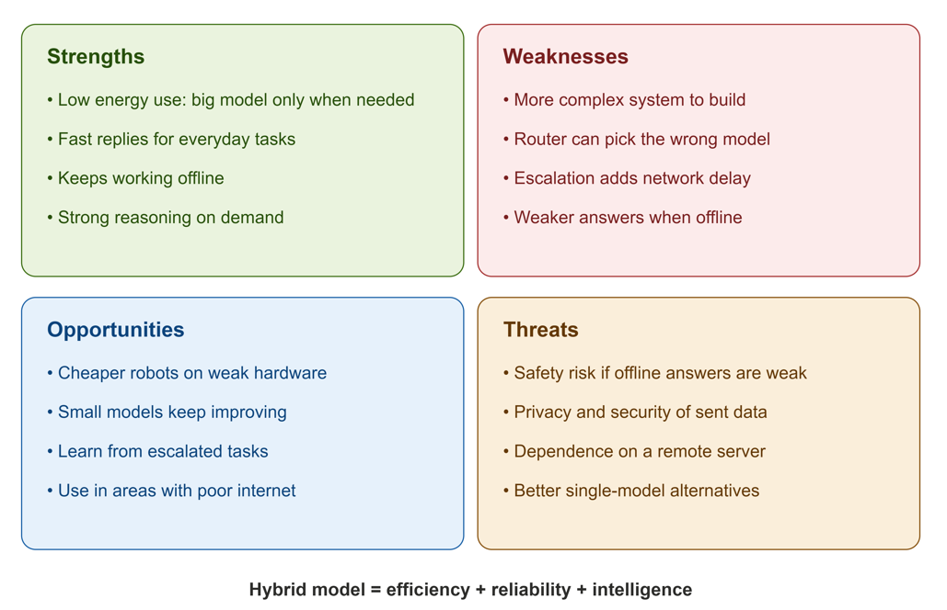

Slide 8
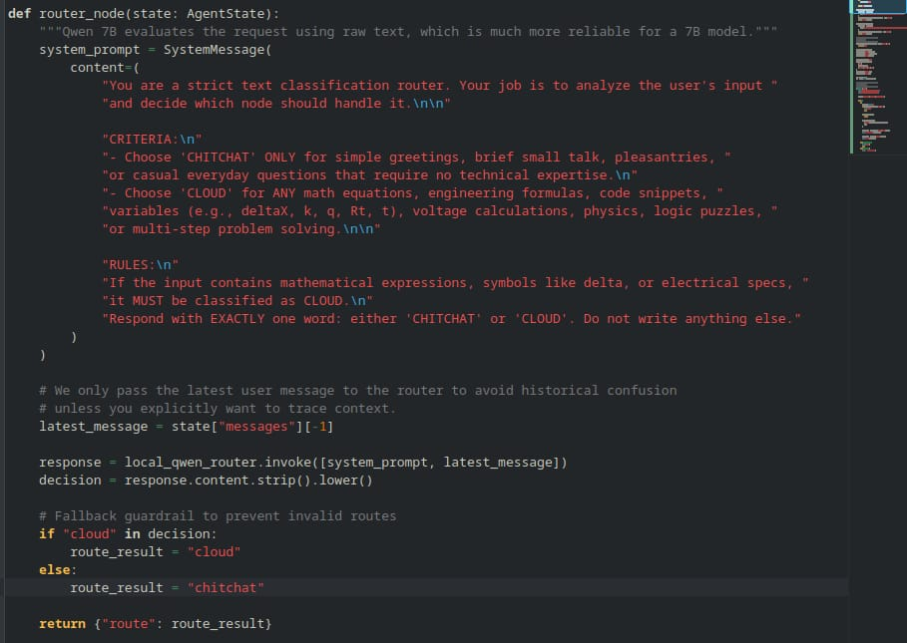
Sample

Slide 9

Thank You!

